Slide 1
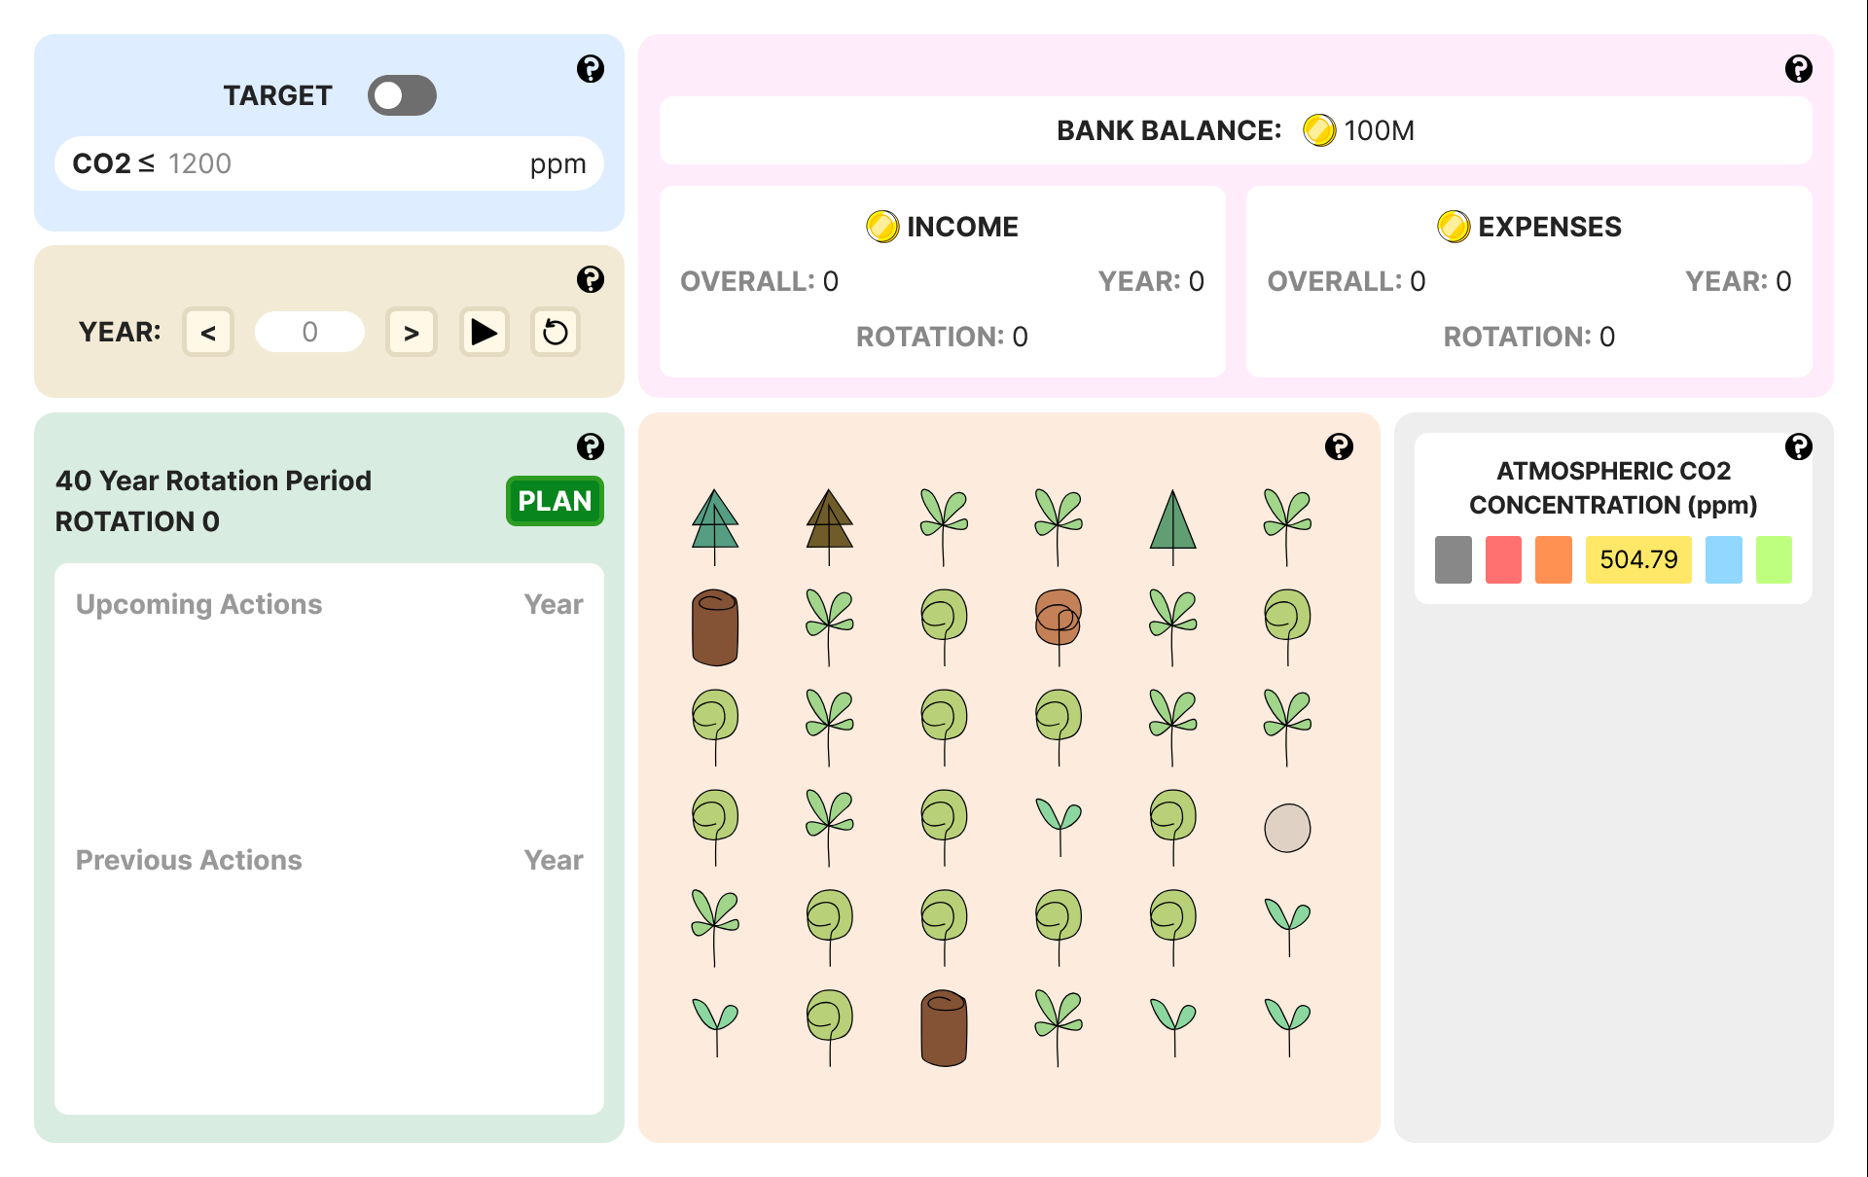
Simple
Static Web App

Slide 2
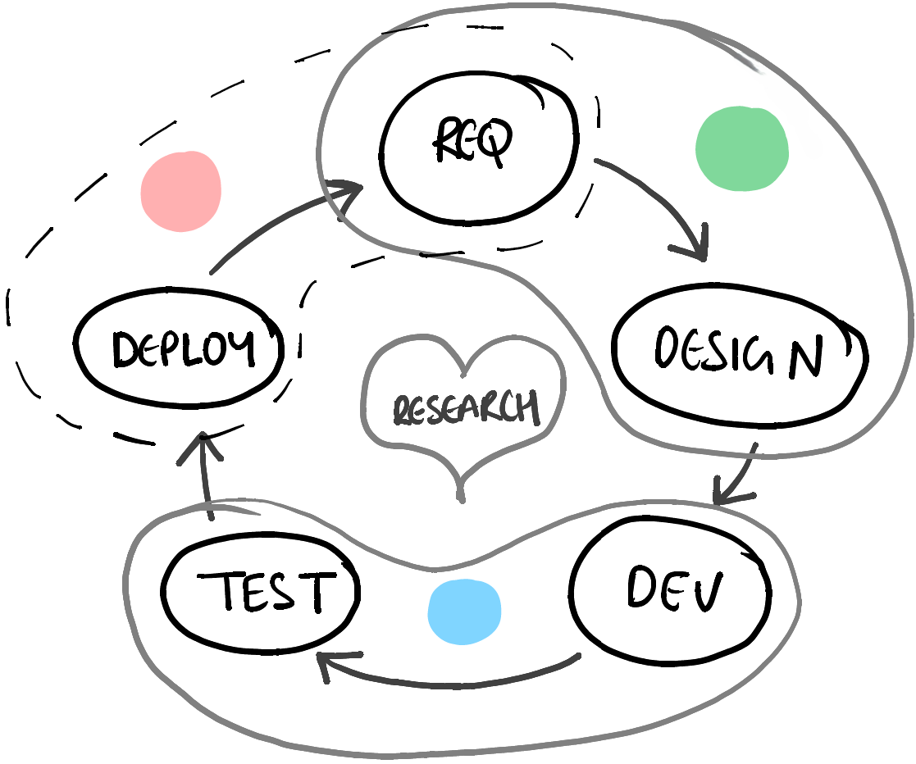
Software Development Life Cycle
Deployment
& Analysis
Planning
Building

Slide 3
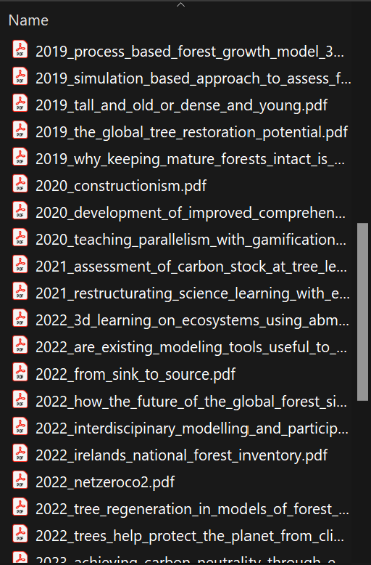
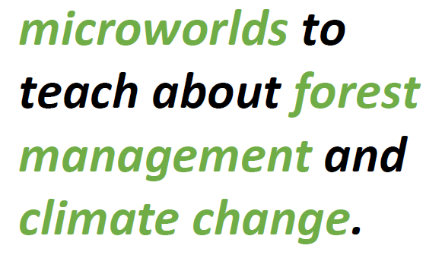

Planning
Feature List
The Idea
…
Research
Discussions

Slide 4
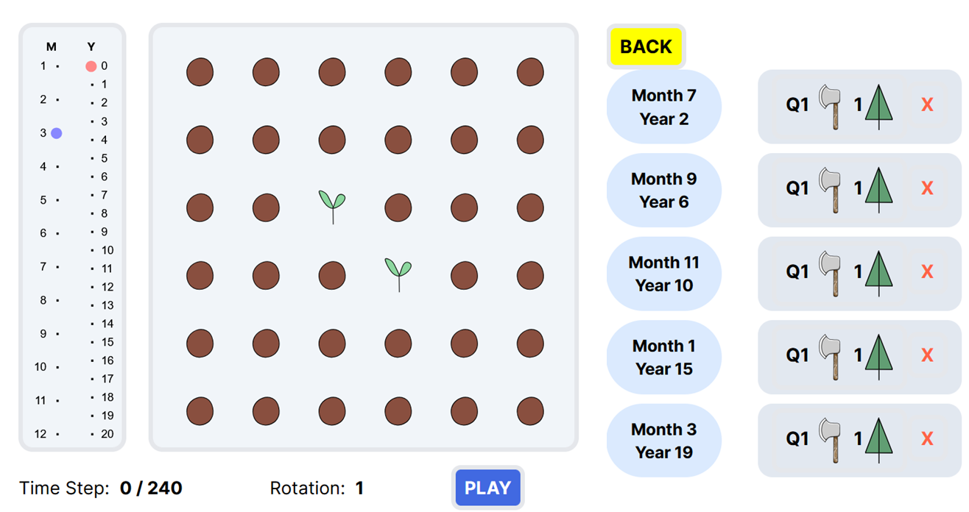
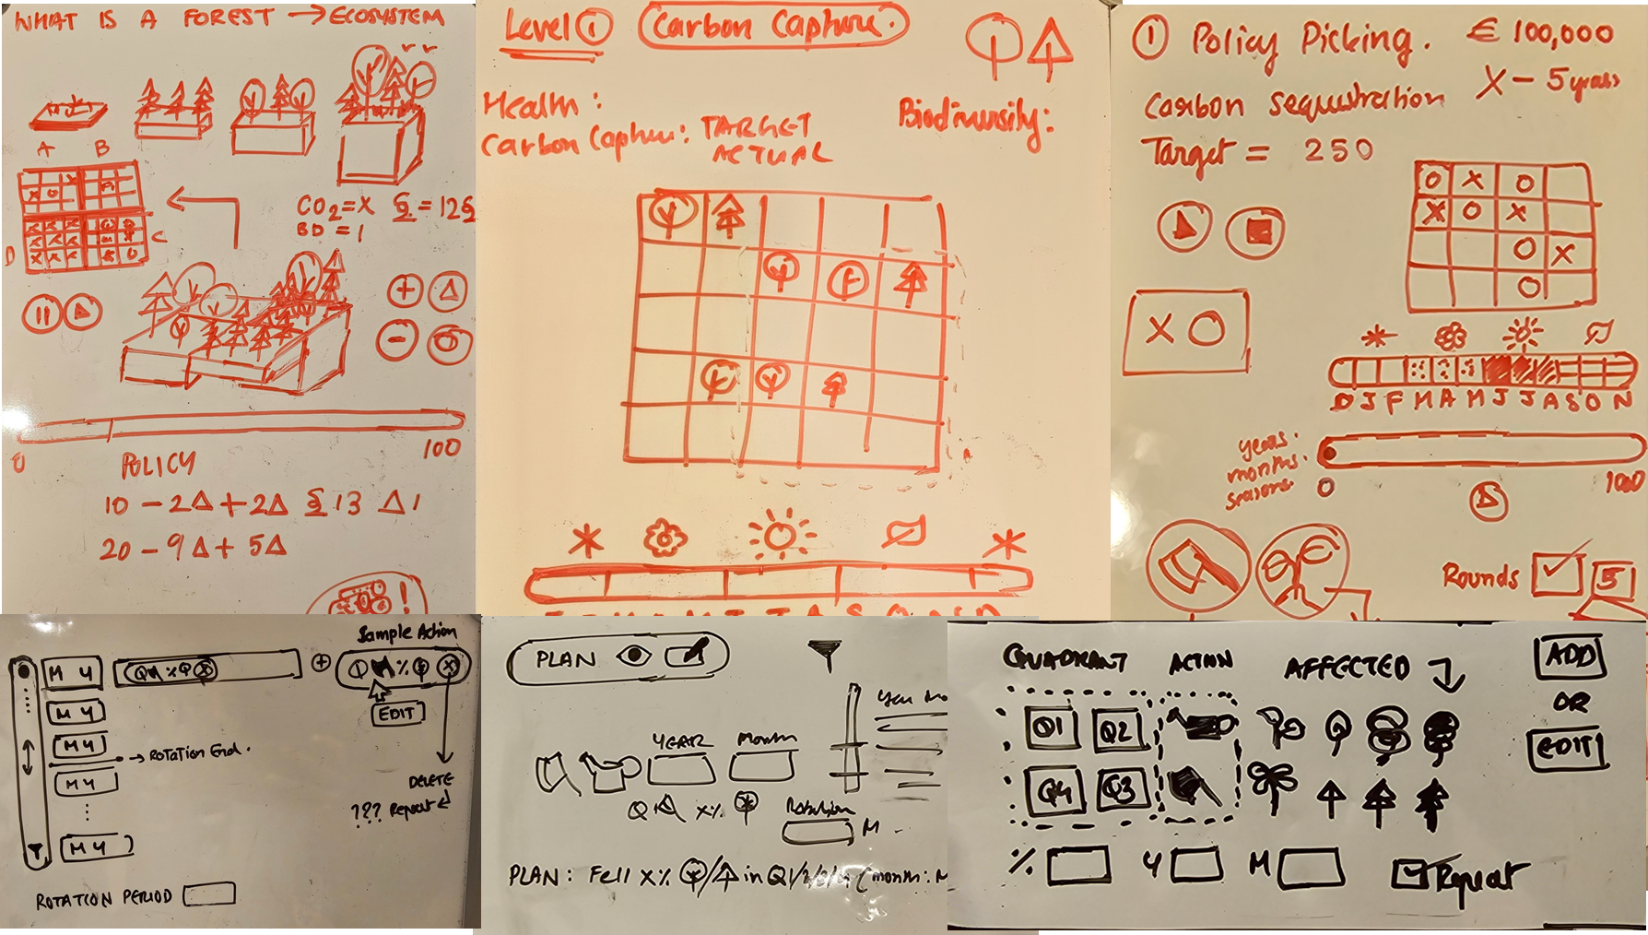
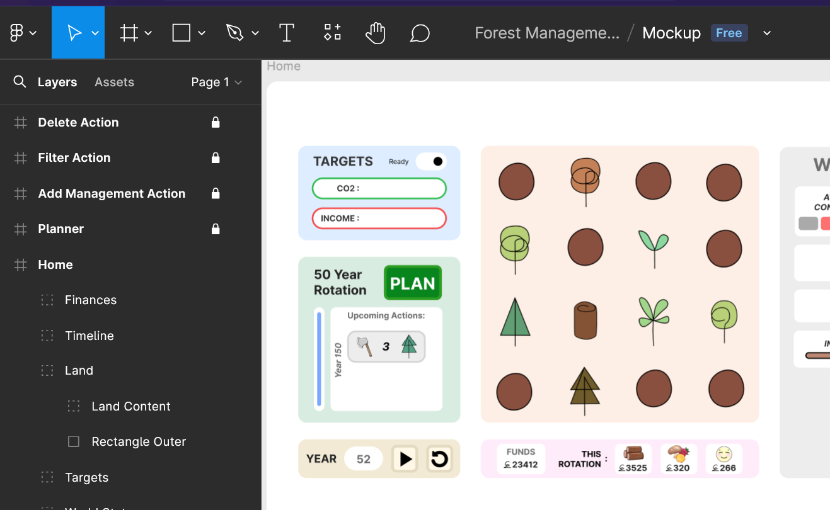
Whiteboard
FIGMA
Code
Mock Up

Slide 5
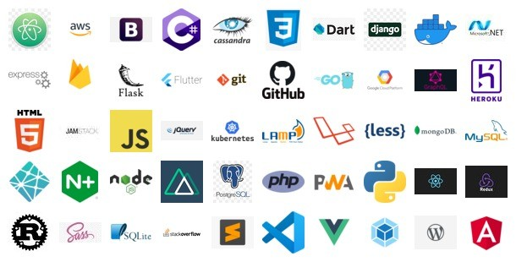
What Technologies ???
Research …
🤯
https://www.linkedin.com/pulse/beginner-friendly-guide-world-web-development-rajat-m/

Slide 6
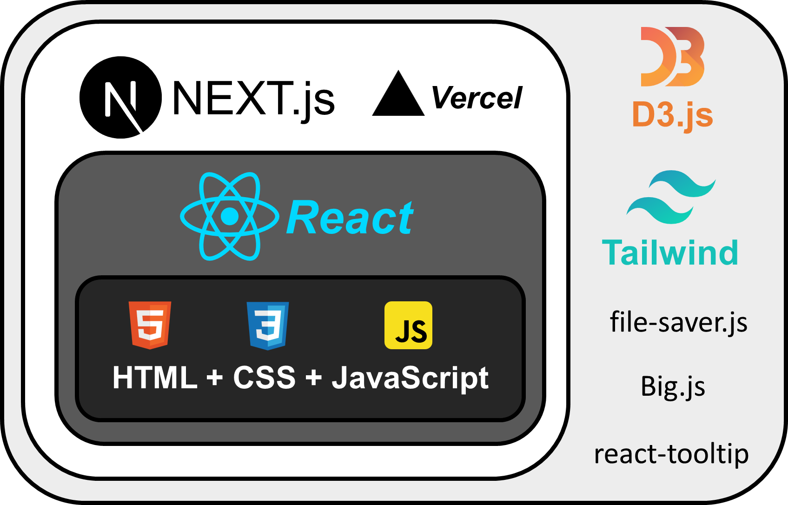
HOSTING
OPTIMIZATION
ORGANIZATION
+ INTERACTION
STRUCTURE
STYLE
ACTION

Slide 7

Execution
🧐

Slide 8
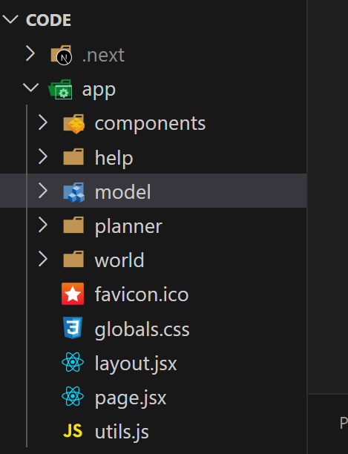
Programming Paradigm
OOP
Design Principles
DRY
Design Patterns
🧐
Model – View - Controller

Slide 9
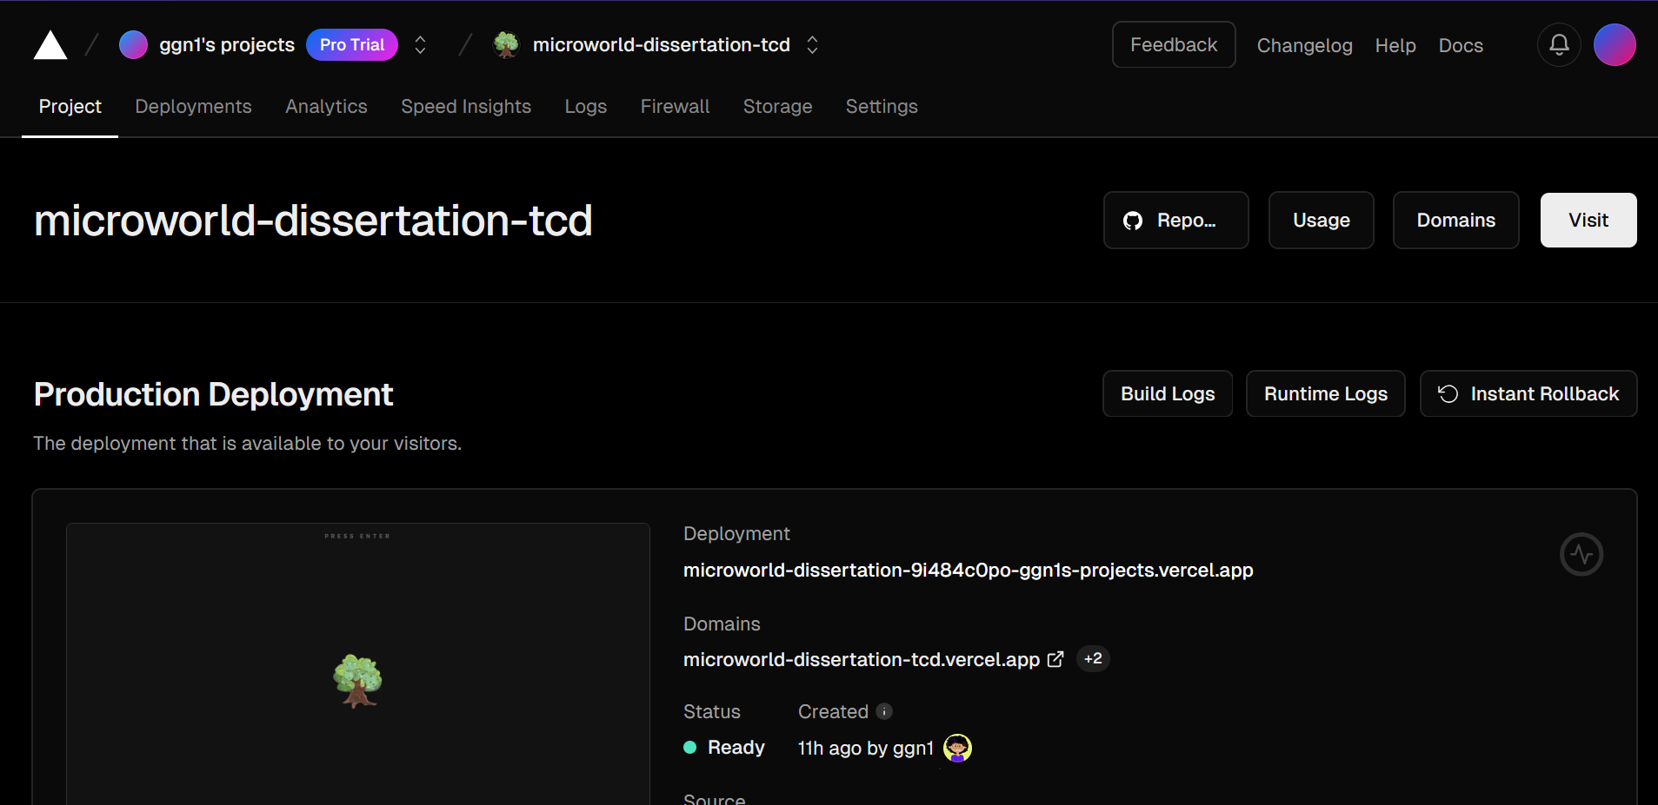
Deployment & Analysis
What Platform ???
Research …
Feedback + Improve

Slide 10
Thank You
😁

